Slide 1
Index laws
Zero powers and scientific notation

Slide 2
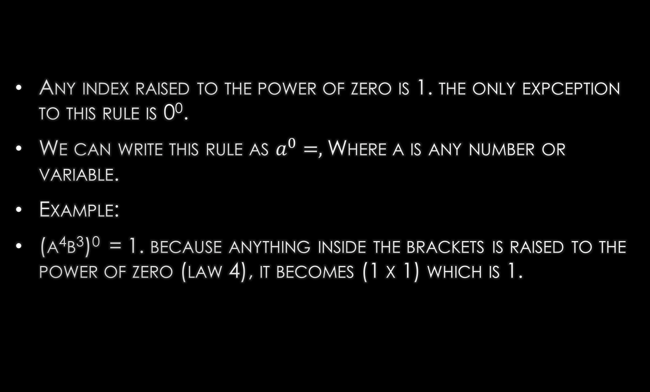
The zero power law:
Any index raised to the power of zero is 1. the only expception to this rule is 0⁰.
We can write this rule as $a^{0}=,$Where a is any number or variable.
Example:
(a⁴b³)⁰ = 1. because anything inside the brackets is raised to the power of zero (law 4), it becomes (1 x 1) which is 1.

Slide 3
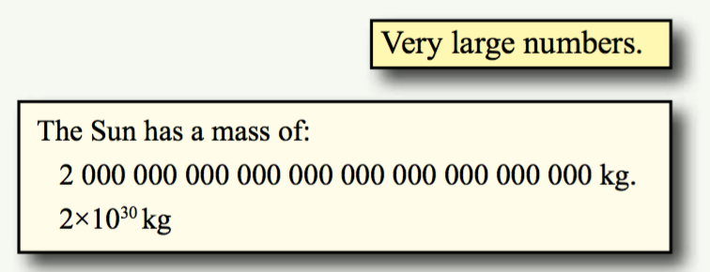
Scientific notation.
When dealing with really large or small numbers, we can write them by collecting Zero’s and using indices to represent he number of zero’s.
We write numbers as decimals multiplied by 10 to n indice.
What does this look like?
The earth is about 150,000,000km from the sun.
EQ: what is scientific notation, and how do we use it to solve problems?

Slide 4
Scientific notation.
EQ: what is scientific notation, and how do we use it to solve problems?
150,000,000.0km’s has 7 zeroes in front of the decimal place. If we moved the decimal point to between the 1 and 5, we would move 8 spaces.
We can rewrite 150,000,000 as 1.5 x 10⁸. this means that therewas 8 moves from the original number to 1.5
NOTE: you only want one number in front of the decimal

Slide 5
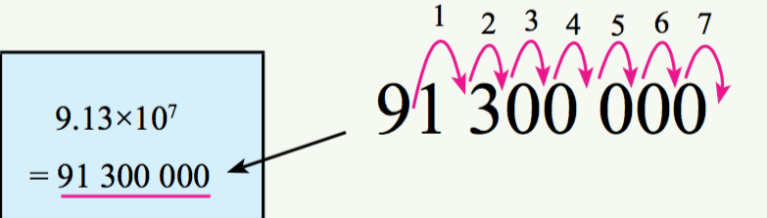
Scientific notation to normal numbers.
EQ: what is scientific notation, and how do we use it to solve problems?
The process for going back to normal numbers from scientific numbers is the reverse of collecting.
An example of this is the number 3.64 x 10⁵. to make this a normal number, we need to move the decimal place RIGHT, equal to the index number.
We need to move the Decimal right 5 spaces, to our number is 364 _ _ _.
To fill in the empty space, we add place holder zeros, writing out number as 364,000.

Slide 6
Significant figures
EQ: what is scientific notation, and how do we use it to solve problems?
When writing large numbers in scientific notation, we often include all numbers besides zeroes*
* zero is significant if it is between and two integers that are not zero – eg 16400 has the significant figures of 1,6 and 4. 16045000 has the significant figures of 1,6,0,4 and 5. the zero is counted as it is between the 6 and 4.
When writing scientific notation, we use significant figure to remain accurate.

Slide 7
Guided practise: write as scientific notation
Tip > add a decimal point at the end of the number.
375000.0
Move the decimal place to between 3 and 7.
3.75000.0 – leave the original decimal at the end of the number.
Count the numbers from the new decimal to the original.
we move 5 spaces, so that is our index
Write the number: 3.75 x10⁵
Write the number with a decimal and zero: 582000.0
Write a new decimal between the 5 and 8 5.82000.0
Count the number of spaces between the new decimal and old – 5 spaces, so that’s our index
Write the number 5.82x10⁵
Write the number with a decimal and zero: 160000.0
Write a new decimal between the 1 and 6 1.62000.0
Count the number of spaces between the new decimal and old – 5 spaces, so that’s our index
Write the number 1.6x10⁵

Slide 8
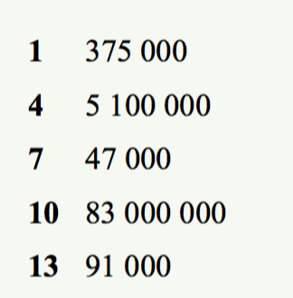
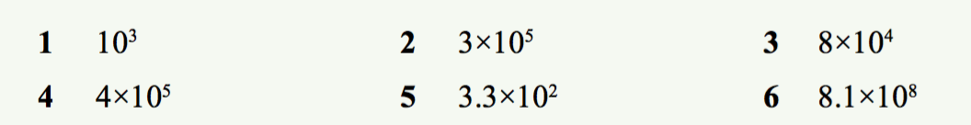
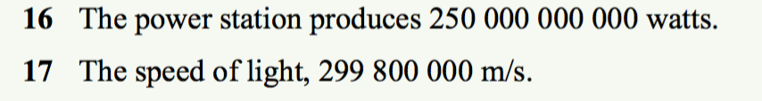
Exercise: Dwyer 9 page 148
Write in scientific notation
Write as ordinary numbers

